Slide 1
# Define the window size
window_size = (64, 64)
# Define the step size
step_size = (8, 8)
# Define how many steps to take in x and y directions
x_steps = np.arange(0, image.shape[1] - window_size[1], step_size[0])
y_steps = np.arange(0, image.shape[0] - window_size[0], step_size[1])
8
image.shape[1] - window_size[1]
64
64
height
== image.shape[0]
width==image.shape[1]

Slide 2
def compute_iou(boxA, boxB):
xA = max(boxA[0], boxB[0]) # xA = 200
yA = max(boxA[1], boxB[1]) # yA = 200
xB = min(boxA[2], boxB[2]) # xB = 300
yB = min(boxA[3], boxB[3]) # yB = 300
interArea = max(0, xB - xA + 1) * max(0, yB - yA + 1)
boxAArea = (boxA[2] - boxA[0] + 1) * (boxA[3] - boxA[1] + 1)
boxBArea = (boxB[2] - boxB[0] + 1) * (boxB[3] - boxB[1] + 1)
iou = interArea / float(boxAArea + boxBArea - interArea)
return iou
(100,100)
boxA
(200,200)
boxB
(300,300)
(400,400)

Slide 3
def compute_iou(boxA, boxB):
xA = max(boxA[0], boxB[0]) # xA = 200
yA = max(boxA[1], boxB[1]) # yA = 200
xB = min(boxA[2], boxB[2]) # xB = 200
yB = min(boxA[3], boxB[3]) # yB = 200
interArea = max(0, xB - xA + 1) * max(0, yB - yA + 1)
boxAArea = (boxA[2] - boxA[0] + 1) * (boxA[3] - boxA[1] + 1)
boxBArea = (boxB[2] - boxB[0] + 1) * (boxB[3] - boxB[1] + 1)
iou = interArea / float(boxAArea + boxBArea - interArea)
return iou
(0,0)
boxB
(200,200)
iou = 0.0000123...
boxA
(400,400)

Slide 4
def compute_iou(boxA, boxB):
xA = max(boxA[0], boxB[0]) # xA = 200
yA = max(boxA[1], boxB[1]) # yA = 200
xB = min(boxA[2], boxB[2]) # xB = 200
yB = min(boxA[3], boxB[3]) # yB = 200
interArea = max(0, xB - xA + 1) * max(0, yB - yA + 1)
boxAArea = (boxA[2] - boxA[0] + 1) * (boxA[3] - boxA[1] + 1)
boxBArea = (boxB[2] - boxB[0] + 1) * (boxB[3] - boxB[1] + 1)
iou = interArea / float(boxAArea + boxBArea - interArea)
return iou
(0,0)
boxB
(200,200)
iou = 0.0000123...
boxA
(400,400)

Slide 5
def non_max_suppression(boxes, probs=None, overlapThresh=0.3):
if len(boxes) == 0:
return []
if boxes.dtype.kind == "i":
boxes = boxes.astype("float")
pick = []
x1 = boxes[:, 0] # [100,100,100,1000,1000]
y1 = boxes[:, 1] # [200,200,200,100,100]
x2 = boxes[:, 2] # [350,400,300,1150,1200]
y2 = boxes[:, 3] # [300,500,800,600,700]
area = (x2 - x1 + 1) * (y2 - y1 + 1)
idxs = probs
idxs = np.argsort(idxs)
boxes=np.array([
[100,200,350,300],
[100,200,400,500],
[100,200,300,800],
[1000,100,1150,600],
[1000,100,1200,700]
])
probs = np.array([0.6,0.7,0.9,0.7,0.8])
0.6 0.7 0.7 0.8 0.9
0 1 3 4 2
(1000,100)
(100,200)
0.7
0.6
(350,300)
0.7
(400,500)
(1150,600)
[ 100. 100. 100. 1000. 1000.]
[200. 200. 200. 100. 100.]
[ 350. 400. 300. 1150. 1200.]
[300. 500. 800. 600. 700.]
0.8
0.9
(1200,700)
(300,800)
(251,101)

Slide 6
while len(idxs) > 0:
last = len(idxs) - 1
i = idxs[last]
pick.append(i)
print(x1[i]) # 100
ptint(x1[idxs[:last]]) # [100,100,1000,1000]
xx1 = np.maximum(x1[i], x1[idxs[:last]])
# [100,100,100,100] [100,100,1000,1000]
# print(xx1) # [100,100,1000,1000]
yy1 = np.maximum(y1[i], y1[idxs[:last]])
# print(yy1) # [200,200,200,200]
xx2 = np.minimum(x2[i], x2[idxs[:last]])
# print(xx2) # [300,300,300,300]
yy2 = np.minimum(y2[i], y2[idxs[:last]])
# print(yy2) # [300,500,600,700]
w = np.maximum(0, xx2 - xx1 + 1)
print(w) # [0,0,0,0] [201,201,-699,-699] => [201,201,0,0]
h = np.maximum(0, yy2 - yy1 + 1)
print(w) # [0,0,0,0] [101,301,401,501] => [101,301,401,501]
print(area[idxs[:last]]) # [251*101,301*301,151*501,201*601]
overlap = (w * h) / area[idxs[:last]]
print(overlap) # [20301,60501,0,0] / [251*101,301*301,151*501,201*601]
# [0.80,0.67,0,0]
print(np.where(overlap > overlapThresh)[0]) # [0,1]
print(np.concatenate(([last],np.where(overlap > overlapThresh)[0]))
# [4,0,1]
idxs = np.delete(idxs, np.concatenate(([last],
np.where(overlap > overlapThresh)[0])))
return pick
boxes=np.array([
[100,200,350,300],
[100,200,400,500],
[100,200,300,800],
[1000,100,1150,600],
[1000,100,1200,700]
])
probs = np.array([0.6,0.7,0.9,0.7,0.8])
0.6 0.7 0.7 0.8 0.9
0 1 3 4 2
(1000,100)
(100,200)
0.7
0.6
(350,300)
0.7
(400,500)
(1150,600)
0.8
0.9
(1200,700)
(300,800)
last
last
idxs
0
1
3
4
2
idxs
3
4
pick
2
pick
2
4

Slide 7
DT=(0.657031, 0.653125, 0.648438, 0.552083)
# box : (centerX, centerY, width, height)
def convertToAbsoluteValues(size, box):
xIn = round(((2 * float(box[0]) - float(box[2])) * size[0] / 2))
yIn = round(((2 * float(box[1]) - float(box[3])) * size[1] / 2))
xEnd = xIn + round(float(box[2]) * size[0])
yEnd = yIn + round(float(box[3]) * size[1])
if xIn < 0:
xIn = 0
if yIn < 0:
yIn = 0
if xEnd >= size[0]:
xEnd = size[0] - 1
if yEnd >= size[1]:
yEnd = size[1] - 1
return (xIn, yIn, xEnd, yEnd)
GT=(0.572656, 0.523958, 0.698438, 0.589583)
size=(640,480)
640
(143,110)
w=0.698438
h=0.589583
(0.572656,0.523958)
480
(590,393)

Slide 8
def AP(detections, groundtruths, classes, IOUThreshold = 0.3, method = 'AP'):
result = []
for c in classes:
dects = [d for d in detections if d[1] == c]
gts = [g for g in groundtruths if g[1] == c]
dects = sorted(dects, key = lambda conf : conf[2], reverse=True)
TP = np.zeros(len(dects))
FP = np.zeros(len(dects))
det = Counter(cc[0] for cc in gts)
for key, val in det.items():
det[key] = np.zeros(val)
dects
[['363', 0.0, 0.92, (280, 69, 696, 435)],
['297', 0.0, 0.77, (499, 286, 791, 455)],
['297', 0.0, 0.33, (138, 173, 335, 330)]]
dects
TP
[['297', 0.0, 0.33, (138, 173, 335, 330)],
['297', 0.0, 0.77, (499, 286, 791, 455)],
['363', 0.0, 0.92, (280, 69, 696, 435)]]
0
0
'297'
0
0
0
'363'
0
FP
'299'
0
0
0
0

Slide 9
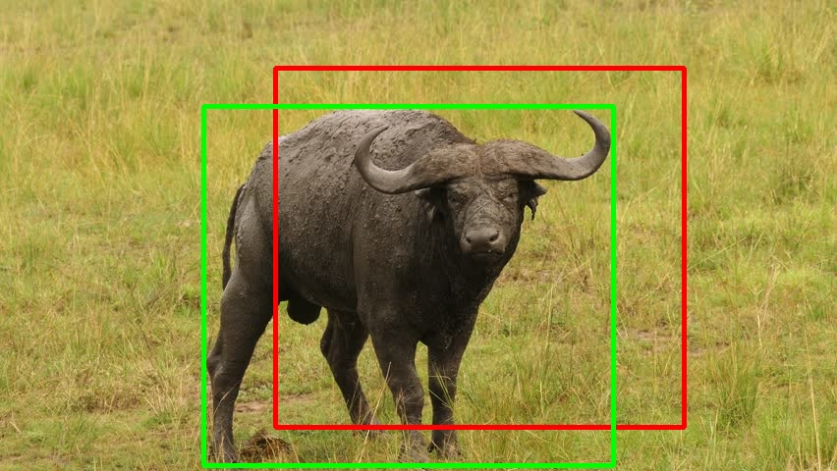
for d in range(len(dects)):
gt = [gt for gt in gts if gt[0] == dects[d][0]]
iouMax = 0
for j in range(len(gt)):
iou1 = iou(dects[d][3], gt[j][3])
if iou1 > iouMax:
iouMax = iou1
jmax = j
if iouMax >= IOUThreshold:
if det[dects[d][0]][jmax] == 0:
TP[d] = 1
det[dects[d][0]][jmax] = 1
else:
FP[d] = 1
else:
FP[d] = 1
dects
[['363', 0.0, 0.92, (280, 69, 696, 435)],
['297', 0.0, 0.77, (499, 286, 791, 455)],
['297', 0.0, 0.33, (138, 173, 335, 330)]]
gts
[['297', 0.0, 1.0, (106, 195, 303, 352)],
['297', 0.0, 1.0, (548, 250, 841, 419)],
['363', 0.0, 1.0, (207, 108, 624, 474)],
['299', 0.0, 1.0, (434, 223, 715, 386)]]
gt
[['363', 0.0, 1.0, (207, 108, 624, 474)]]
d
363
det
TP
iouMax
jmax
0
0
'297'
1
0
0
0.59
0
'363'
1
FP
'299'
0
0
0
0

Slide 10
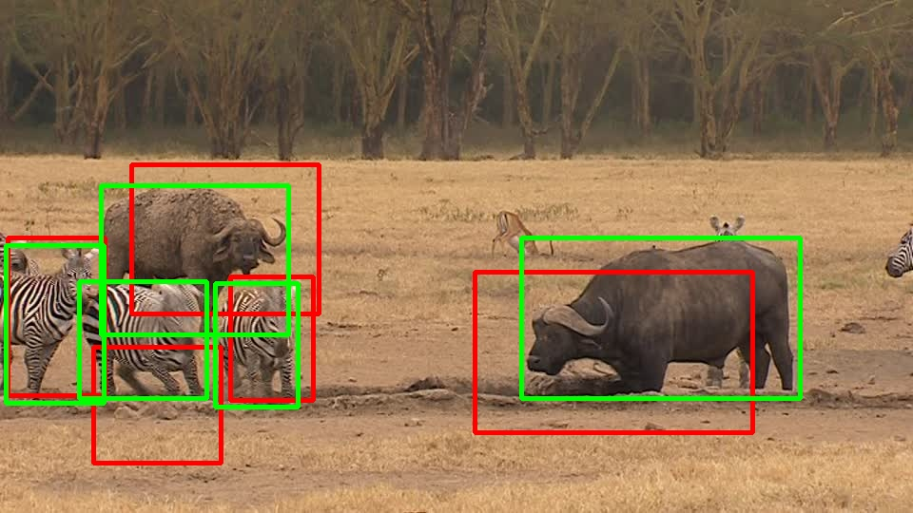
for d in range(len(dects)):
gt = [gt for gt in gts if gt[0] == dects[d][0]]
iouMax = 0
for j in range(len(gt)):
iou1 = iou(dects[d][3], gt[j][3])
if iou1 > iouMax:
iouMax = iou1
jmax = j
if iouMax >= IOUThreshold:
if det[dects[d][0]][jmax] == 0:
TP[d] = 1
det[dects[d][0]][jmax] = 1
else:
FP[d] = 1
else:
FP[d] = 1
dects
[['363', 0.0, 0.92, (280, 69, 696, 435)],
['297', 0.0, 0.77, (499, 286, 791, 455)],
['297', 0.0, 0.33, (138, 173, 335, 330)]]
gts
[['297', 0.0, 1.0, (106, 195, 303, 352)],
['297', 0.0, 1.0, (548, 250, 841, 419)],
['363', 0.0, 1.0, (207, 108, 624, 474)],
['299', 0.0, 1.0, (434, 223, 715, 386)]]
gt
[['297', 0.0, 1.0, (106, 195, 303, 352)],
['297', 0.0, 1.0, (548, 250, 841, 419)]]
d
297
det
TP
iouMax
jmax
1
1
'297'
1
1
1
0.56
0
'363'
1
FP
'299'
0
0
0
0

Slide 11
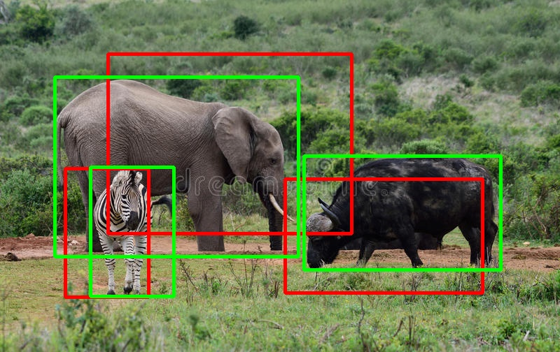
acc_FP = np.cumsum(FP)
acc_TP = np.cumsum(TP)
rec = acc_TP / npos
prec = np.divide(acc_TP, (acc_FP + acc_TP))
dects
[['363', 0.0, 0.92, (280, 69, 696, 435)],
['297', 0.0, 0.77, (499, 286, 791, 455)],
['297', 0.0, 0.33, (138, 173, 335, 330)]]
acc_FP
acc_TP
rec
prec
gts
0
0
0
1
2
3
0.25
0.50
0.75
1.0
1.0
1.0
[['297', 0.0, 1.0, (106, 195, 303, 352)],
['297', 0.0, 1.0, (548, 250, 841, 419)],
['363', 0.0, 1.0, (207, 108, 624, 474)],
['299', 0.0, 1.0, (434, 223, 715, 386)]]
d
det
TP
npos
1
1
gt
'297'
1
1
1
4
'363'
[['297', 0.0, 1.0, (106, 195, 303, 352)],
['297', 0.0, 1.0, (548, 250, 841, 419)]]
1
FP
'299'
0
0
0
0
363
297
299

Slide 12
def calculateAveragePrecision(rec, prec):
mrec = [0] + [e for e in rec] + [1]
mpre = [0] + [e for e in prec] + [0]
for i in range(len(mpre)-1, 0, -1):
mpre[i-1] = max(mpre[i-1], mpre[i])
ii = []
for i in range(len(mrec)-1):
if mrec[1:][i] != mrec[0:-1][i]:
ii.append(i+1)
ap = 0
for i in ii:
ap = ap + np.sum((mrec[i] - mrec[i-1]) * mpre[i])
return [ap, mpre[0:len(mpre)-1], mrec[0:len(mpre)-1], ii]
rec
prec
0.25
0.50
0.75
1.0
1.0
1.0
mrec
0.0
0.25
0.50
0.75
1.0
mpre
1.0
1.0
1.0
1.0
0.0
0.25
0.50
0.75
0.75
0.0
0.25
0.50
0.75
ii
1
2
3
4
ap
0.75
363
297
299

Slide 13
Selective search 알고리즘을 통해 객체가 있을 법할 위치인 후보 영역(region proposal)을 2000개 추출하여, 각각을 227x227 크기로 warp시켜줍니다.
Warp된 모든 region proposal을 Fine tune된 AlexNet에 입력하여 2000x4096 크기의 feature vector를 추출합니다.
추출된 feature vector를 linear SVM 모델과 Bounding box regressor 모델에 입력하여 각각 confidence score와 조정된 bounding box 좌표를 얻습니다.
마지막으로 Non maximum suppression 알고리즘을 적용하여 최소한의, 최적의 bounding box를 출력합니다.

Slide 15
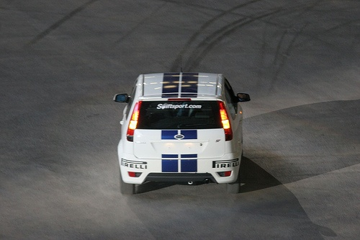
1. Fine tuning pre-trained AlexNet
Positive samples
370*1400
crop, resize 됨
warp
IOU>0.5
PASCAL
VOC
...
(128,227,227)
(128,2)
Pre-trained
AlexNet
한개의 이미지
최대 2000개
region
IOU<0.5
Mini batches(128)
Negative samples

Slide 16
2. Training linear SVM using fine tuned AlexNet
Positive samples
IOU>0.3
(128,2)
PASCAL
VOC
...
(128,227,227)
(128,4096)
Fine-tuned
AlexNet
Linear
SVM
한개의 이미지
최대 2000개
region
IOU<0.3
Mini batches(128)
Negative samples
Hard negative Mining

Slide 17
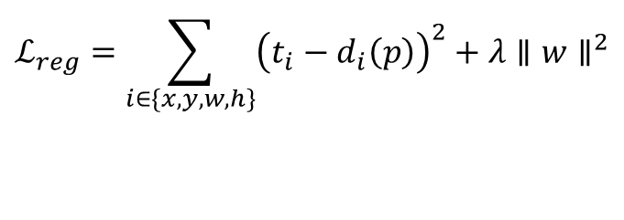
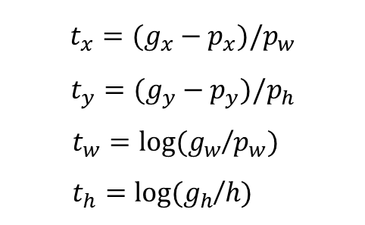
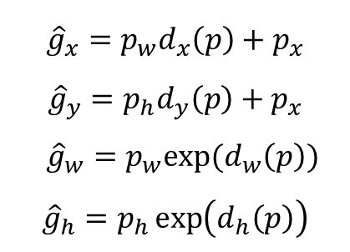
SS Predicted
수정 예측 값
Target
$${\hat{g}}_{x}=p_{w}d_{x}\left(p\right)+p_{x}$$
$${\hat{g}}_{y}=p_{h}d_{y}\left(p\right)+p_{x}$$
${\hat{g}}_{w}=p_{w}exp⁡(d_{w}\left(p\right))$
$${\hat{g}}_{h}=p_{h}\exp\left(d_{h}\left(p\right)\right)$$
Ground Truth
$$t_{x}=(g_{x}−p_{x})/p_{w}$$
$$t_{y}=(g_{y}−p_{y})/p_{h}$$
$t_{w}=log⁡(g_{w}$/$p_{w})$
$t_{h}=log⁡(g_{h}$/$h)$
손실 함수
SSE(Sum of Squared Error)
$$ℒ_{reg}=\sum_{i∈\{x,y,w,h\}}{{\left(t_{i}−d_{i}\left(p\right)\right)}^{2}+λ∥w∥^{2}}$$

Slide 18
3. Training Bounding box regressor using fine tuned AlexNet
Positive samples
(128,4)
PASCAL
VOC
(128,227,227)
(128,4096)
Bounding
Box
Regressor
IOU>0.6
Fine-tuned
AlexNet
한개의 이미지
최대 2000개
region
Feature vector

Slide 19
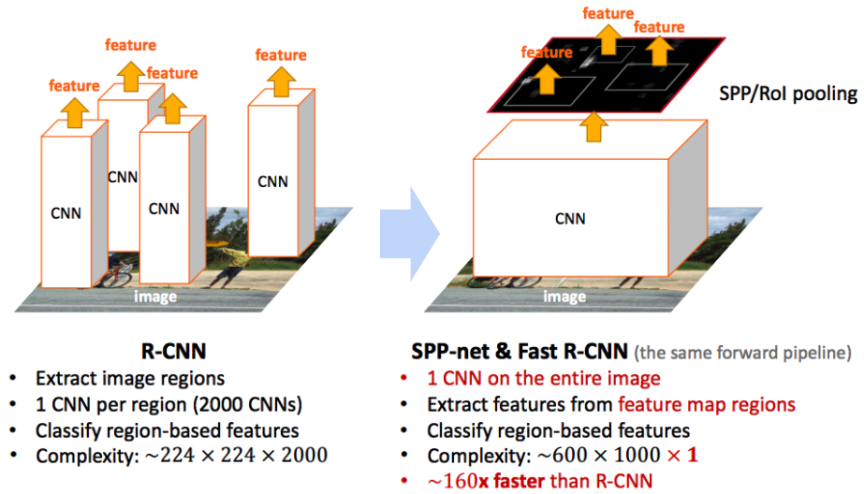
R-CNN vs Fast R-CNN

Slide 20
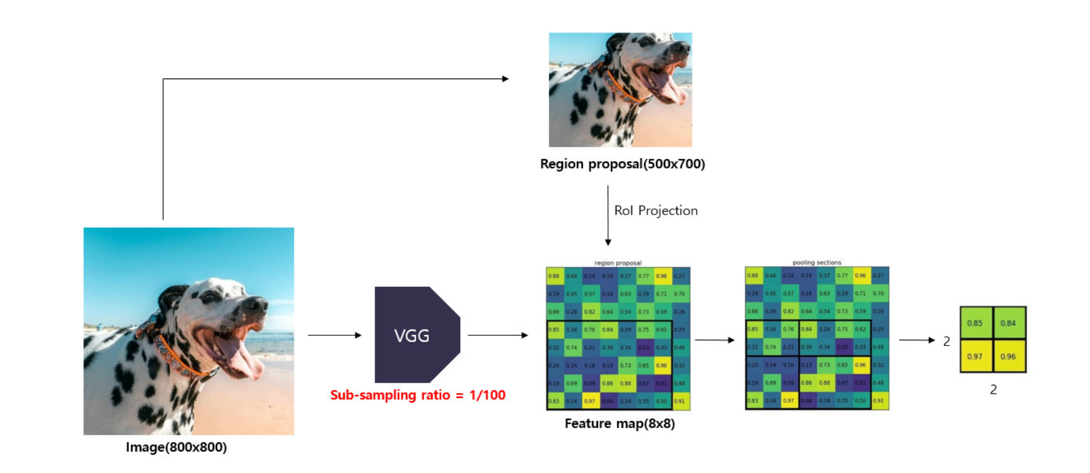
RoI pooling 개념
(0,300)
(0,3)
(700,800)
(7,8)

Slide 21
R-CNN vs Fast R-CNN
K=20
K+1 (백그라운드 포함)
clasifier
((K+1)*1,)
최대 2000개
region
Truncated SVD
PASCAL
VOC
Pre-trained
VGG
(224,224,3)
(14,14,512)
(7,7,512)
Multi-task
loss
(25088)
한개의 이미지
RoI
pooling
((K+1)*4,)
Feature vector
(4096,)
Bounding box
regressor

Slide 22
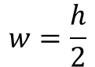
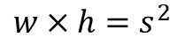
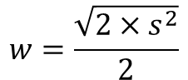
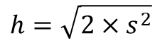
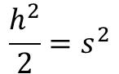
[1:1, 1:2, 2:1]
(128,128)
(256,256)
(512,512)
128
91
$$w×h=s^{2}$$
181
$$w=\frac{h}{2}$$
128
181
91
$$\frac{h^{2}}{2}=s^{2}$$
$$h=\sqrt{2×s^{2}}$$
$$w=\frac{\sqrt{2×s^{2}}}{2}$$

Slide 23
0
16
32
48
800
..
16
..
.
..
.
.
..
.
.
.
..
.
.
.
..
.
.
.
..
..
..
..
..
..

Slide 24
0
16
32
48
64
800
..
16
..
.
..
.
.
..
.
.
.
..
.
.
.
..
.
.
.
..
..
..
..
..
..

Slide 25
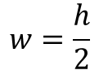
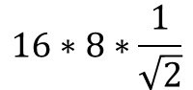
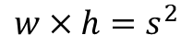
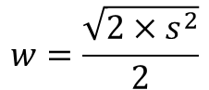
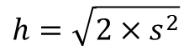
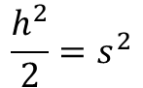
[1:1, 1:2, 2:1]
(128,128)
(256,256)
(512,512)
$$w×h=s^{2}$$
ratios = [0.5, 1, 2]
scales = [8, 16, 32]
sub_sample = 16
anchor_boxes = np.zeros(((feature_size * feature_size * 9), 4))
index = 0
for c in ctr: # per anchors
ctr_y, ctr_x = c
for i in range(len(ratios)): # per ratios
for j in range(len(scales)): # per scales
# anchor box height, width
h = sub_sample * scales[j] * np.sqrt(ratios[i])
w = sub_sample * scales[j] * np.sqrt(1./ ratios[i])
# anchor box [x1, y1, x2, y2]
anchor_boxes[index, 1] = ctr_y - h / 2.
anchor_boxes[index, 0] = ctr_x - w / 2.
anchor_boxes[index, 3] = ctr_y + h / 2.
anchor_boxes[index, 2] = ctr_x + w / 2.
index += 1
$$w=\frac{h}{2}$$
(50*50*9,4)
$$\frac{h^{2}}{2}=s^{2}$$
$$16∗8∗\frac{1}{\sqrt{2}}$$
$$h=\sqrt{2×s^{2}}$$
$$w=\frac{\sqrt{2×s^{2}}}{2}$$
128
91
181
128
181
91

Slide 26
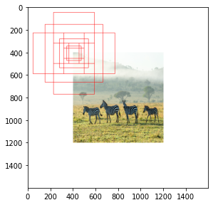

Slide 27
Anchor
generation
layer
Anchor boxes
Anchor
target
layer
index_inside = np.where(
(anchor_boxes[:, 0] >= 0) &
(anchor_boxes[:, 1] >= 0) &
(anchor_boxes[:, 2] <= 800) &
(anchor_boxes[:, 3] <= 800))[0]
print(index_inside.shape)
# only 8940 anchor boxes are inside the boundary out of 22500
valid_anchor_boxes = anchor_boxes[index_inside]
print(valid_anchor_boxes.shape)

Slide 28
2) Calculate IoUs
ious = np.empty((len(valid_anchor_boxes),4), dtype=np.float32)
ious.fill(0)
# anchor boxes
for i, anchor_box in enumerate(valid_anchor_boxes):
xa1, ya1, xa2, ya2 = anchor_box
anchor_area = (xa2 - xa1) * (ya2 - ya1)
# ground truth boxes
for j, gt_box in enumerate(bbox):
xb1, yb1, xb2, yb2 = gt_box
box_area = (xb2 - xb1) * (yb2 - yb1)
inter_x1 = max([xb1, xa1])
inter_y1 = max([yb1, ya1])
inter_x2 = min([xb2, xa2])
inter_y2 = min([yb2, ya2])
...

Slide 29
2) Calculate IoUs
ious = np.empty((len(valid_anchor_boxes),4), dtype=np.float32)
ious.fill(0)
# anchor boxes
...
if (inter_x1 < inter_x2) and (inter_y1 < inter_y2):
inter_area = (inter_x2 - inter_x1) * (inter_y2 - inter_y1)
iou = inter_area / (anchor_area + box_area - inter_area)
else:
iou = 0
ious[i, j] = iou

Slide 30
3) Sample positive/negative anchor boxes
gt_argmax_ious = ious.argmax(axis=0)
print(gt_argmax_ious)
gt_max_ious = ious[gt_argmax_ious, np.arange(ious.shape[1])]
# ious[[1008, 2862, 5935, 8699], [0,1,2,3]]
print(gt_max_ious)
gt_argmax_ious = np.where(ious == gt_max_ious)[0]
print(gt_argmax_ious)
(8940,4)
[[0.58514285 0. 0. 0. ]
[0.16435339 0.5752716 0. 0. ]
[0. 0. 0.5255493 0. ]
[0. 0. 0. 0.6325869 ]]

Slide 31
3) Sample positive/negative anchor boxes
...
label = np.empty((len(index_inside),), dtype=np.int32)
label.fill(-1)
print(label.shape)
pos_iou_threshold = 0.7
neg_iou_threshold = 0.3
label[gt_argmax_ious] = 1
label[max_ious >= pos_iou_threshold] = 1
label[max_ious < neg_iou_threshold] = 0

Slide 32
3) Sample positive/negative anchor boxes
n_sample = 256
pos_ratio = 0.5
n_pos = pos_ratio * n_sample
pos_index = np.where(label == 1)[0]
if len(pos_index) > n_pos:
disable_index = np.random.choice(pos_index,
size = (len(pos_index) - n_pos),
replace=False)
label[disable_index] = -1
n_neg = n_sample * np.sum(label == 1)
neg_index = np.where(label == 0)[0]
if len(neg_index) > n_neg:
disable_index = np.random.choice(neg_index,
size = (len(neg_index) - n_neg),
replace = False)
label[disable_index] = -1

Slide 33
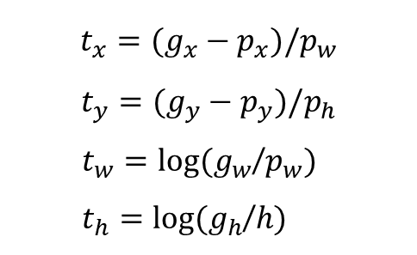
height = valid_anchor_boxes[:, 3] - valid_anchor_boxes[:, 1]
width = valid_anchor_boxes[:, 2] - valid_anchor_boxes[:, 0]
ctr_y = valid_anchor_boxes[:, 1] + 0.5 * height
ctr_x = valid_anchor_boxes[:, 0] + 0.5 * width
base_height = max_iou_bbox[:, 3] - max_iou_bbox[:, 1]
base_width = max_iou_bbox[:, 2] - max_iou_bbox[:, 0]
base_ctr_y = max_iou_bbox[:, 1] + 0.5 * base_height
base_ctr_x = max_iou_bbox[:, 0] + 0.5 * base_width
eps = np.finfo(height.dtype).eps
print(eps)
print(height.shape, width.shape)
height = np.maximum(height, eps)
width = np.maximum(width, eps)
print(height[1000:1100])
print(height.shape, width.shape)
dy = (base_ctr_y - ctr_y) / height
dx = (base_ctr_x - ctr_x) / width
dh = np.log(base_height / height)
dw = np.log(base_width / width)
$$t_{x}=(g_{x}−p_{x})/p_{w}$$
$$t_{y}=(g_{y}−p_{y})/p_{h}$$
$t_{w}=log⁡(g_{w}$/$p_{w})$
$t_{h}=log⁡(g_{h}$/$h)$
anchor_locs
[[ 1.24848541 2.49973296 0.56971714 -0.03381788]
[ 1.24848541 2.41134461 0.56971714 -0.03381788]
[ 1.24848541 2.32295626 0.56971714 -0.03381788]
...
[-0.5855728 -0.63252911 0.4917556 -0.03381788]
[-0.5855728 -0.72091746 0.4917556 -0.03381788]
[-0.5855728 -0.80930581 0.4917556 -0.03381788]]

Slide 34
RPN
(1,36,50,50)
(36,512,1,1)
Conv
(1,512,50,50)
Pre-trained
VGG
(1,3,800,800)
(1,512,50,50)
(512,512,3,3)
Conv
(1,18,50,50)
in_channels = 512
mid_channels = 512
n_anchor = 9
conv1 = nn.Conv2d(in_channels, mid_channels, 3, 1, 1).to(DEVICE)
conv1.weight.data.normal_(0, 0.01)
conv1.bias.data.zero_()
# bounding box regressor
reg_layer = nn.Conv2d(mid_channels, n_anchor * 4, 1, 1, 0).to(DEVICE)
reg_layer.weight.data.normal_(0, 0.01)
reg_layer.bias.data.zero_()
# classifier(object or not)
cls_layer = nn.Conv2d(mid_channels, n_anchor * 2, 1, 1, 0).to(DEVICE)
cls_layer.weight.data.normal_(0, 0.01)
cls_layer.bias.data.zero_()
(18,512,1,1)
Conv

Slide 35
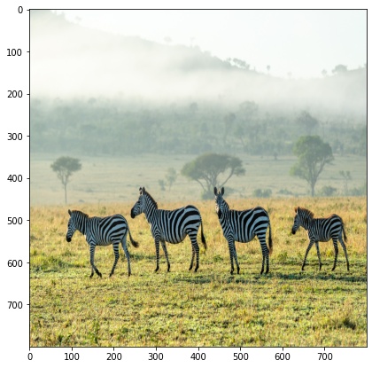
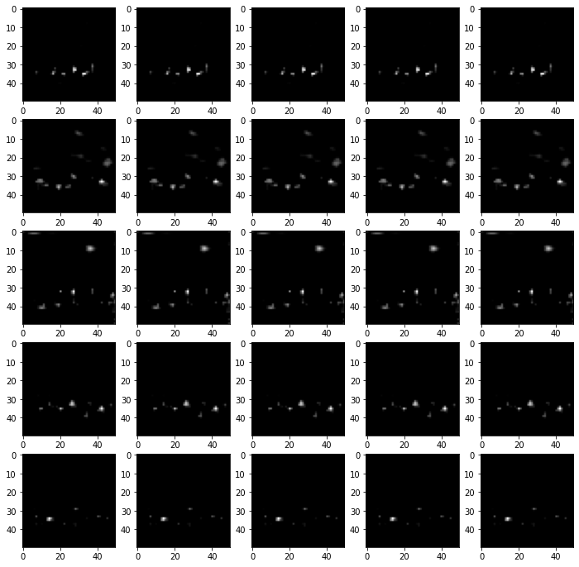
RPN
=>(1,50,50,36)=>(1,50*50*9,4)
(1,36,50,50)
pred_anchor_locs
(1,22500,4)
pred_anchor_locs
(36,512,1,1)
reg_layer
(1,512,50,50)
Pre-trained
VGG
(1,3,800,800)
(1,512,50,50)
=>(1,50,50,18)=>(1,50*50*9,2)
(512,512,3,3)
Conv1
(1,18,50,50)
pred_cls_scores
(1,22500,2)
pred_cls_scores
(18,512,1,1)
cls_layer
(1,22500)
objectness_score
x = conv1(output_map.to(DEVICE)) # output_map = faster_rcnn_feature_extractor(imgTensor)
pred_anchor_locs = reg_layer(x) # bounding box regresor output
pred_cls_scores = cls_layer(x) # classifier output
print(pred_anchor_locs.shape, pred_cls_scores.shape)

Slide 36
RPN
=>(1,50,50,36)=>(1,50*50*9,4)
(1,36,50,50)
pred_anchor_locs
(1,22500,4)
pred_anchor_locs
(36,512,1,1)
reg_layer
(1,512,50,50)
Pre-trained
VGG
(1,3,800,800)
(1,512,50,50)
=>(1,50,50,18)=>(1,50*50*9,2)
(512,512,3,3)
Conv1
(1,18,50,50)
pred_cls_scores
(1,22500,2)
pred_cls_scores
(18,512,1,1)
cls_layer
(1,22500)
objectness_score
rpn_cls_loss = F.cross_entropy(rpn_score, gt_rpn_score.long().to(DEVICE), ignore_index = -1)
x = torch.abs(mask_loc_targets.cpu() - mask_loc_preds.cpu())
rpn_loc_loss = ((x < 1).float() * 0.5 * x ** 2) + ((x >= 1).float() * (x - 0.5))
rpn_lambda = 10
N_reg = (gt_rpn_score > 0).float().sum()
rpn_loc_loss = rpn_loc_loss.sum() / N_reg
rpn_loss = rpn_cls_loss + (rpn_lambda * rpn_loc_loss)

Slide 37
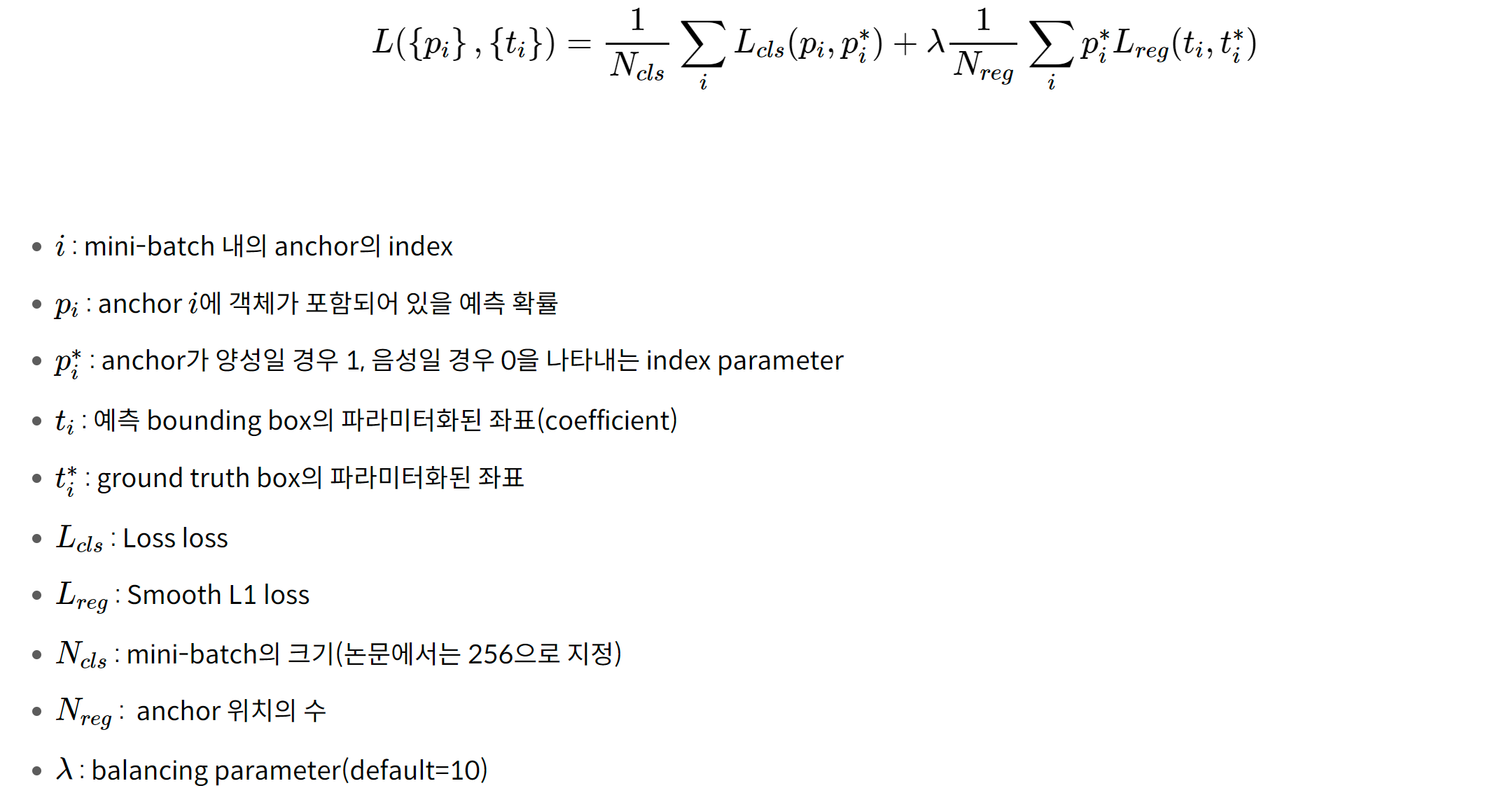
rpn_cls_loss = F.cross_entropy(rpn_score, gt_rpn_score.long().to(DEVICE), ignore_index = -1)
x = torch.abs(mask_loc_targets.cpu() - mask_loc_preds.cpu())
rpn_loc_loss = ((x < 1).float() * 0.5 * x ** 2) + ((x >= 1).float() * (x - 0.5))
rpn_lambda = 10
N_reg = (gt_rpn_score > 0).float().sum()
rpn_loc_loss = rpn_loc_loss.sum() / N_reg
rpn_loss = rpn_cls_loss + (rpn_lambda * rpn_loc_loss)

Slide 38
Resion
proposals
2000개
Proposal
layer
Proposal
target
layer
class score,
bbox regressors
RoIs
Pre-trained
VGG
RPN
(1,512,50,50)
(1,3,800,800)
Rol
pooling
Fast
RCNN
(1,512,50,50)

Slide 39
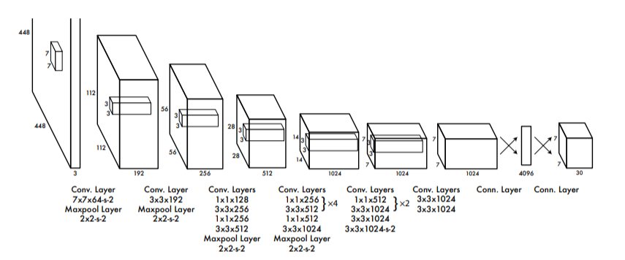
architecture_config = [
(7, 64, 2, 3), => (1,64,224,224)
"M", => (1,64,112,112)
(3, 192, 1, 1),
"M",
(1, 128, 1, 0),
(3, 256, 1, 1),
(1, 256, 1, 0),
(3, 512, 1, 1),
"M",
[(1, 256, 1, 0), (3, 512, 1, 1), 4],
(1, 512, 1, 0),
(3, 1024, 1, 1),
"M",
[(1, 512, 1, 0), (3, 1024, 1, 1), 2],
(3, 1024, 1, 1),
(3, 1024, 2, 1),
(3, 1024, 1, 1),
(3, 1024, 1, 1),
]
(1,3,448,448)
N=448
F=7
S=2
P=3
FN=64
(1,64,224,224)
0
0
0
0
0
0
N-F+1+2P
---------
S
448-7+1+3*2
-----------
2
0
1
2
3
4
0
0
5
6
7
8
0
0
9
10
11
12
0
0
13
14
15
16
0
0
0
0
0
0
0

Slide 40
architecture_config = [
(7, 64, 2, 3), => (1,64,224,224)
"M", => (1,64,112,112)
(3, 192, 1, 1),
"M", => (1,192,56,56)
(1, 128, 1, 0),
(3, 256, 1, 1),
(1, 256, 1, 0),
(3, 512, 1, 1),
"M",
[(1, 256, 1, 0), (3, 512, 1, 1), 4],
(1, 512, 1, 0),
(3, 1024, 1, 1),
"M",
[(1, 512, 1, 0), (3, 1024, 1, 1), 2],
(3, 1024, 1, 1),
(3, 1024, 2, 1),
(3, 1024, 1, 1),
(3, 1024, 1, 1),
]
(1,64,112,112)
F=3
S=1
P=1
FN=192
(1,192,112,112)
N-F+1+2P
---------
S
112-3+1+1*2
-----------
1

Slide 41
architecture_config = [
(7, 64, 2, 3), => (1,64,224,224)
"M", => (1,64,112,112)
(3, 192, 1, 1),
"M", => (1,192,56,56)
(1, 128, 1, 0), => (1,128,56,56)
(3, 256, 1, 1), => (1,256,56,56)
(1, 256, 1, 0), => (1,256,56,56)
(3, 512, 1, 1), => (1,512,56,56)
"M", => (1,512,28,28)
[(1, 256, 1, 0), (3, 512, 1, 1), 4],
(1, 512, 1, 0),
(3, 1024, 1, 1),=> (1,1024,28,28)
"M", => (1,1024,14,14)
[(1, 512, 1, 0), (3, 1024, 1, 1), 2],
(3, 1024, 1, 1),
(3, 1024, 2, 1),=> (1,1024,7,7)
(3, 1024, 1, 1),
(3, 1024, 1, 1),
]
(1,192,56,56)
F=1
S=1
P=0
FN=128
(1,128,56,56)
N-F+1+2P
---------
S
56-1+1+0*2
-----------
1

Slide 42
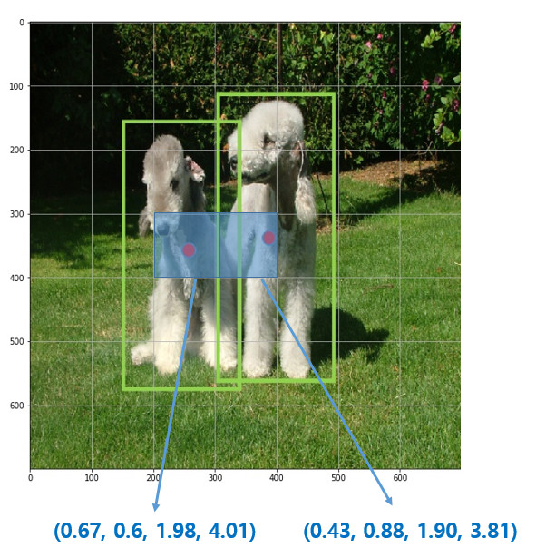
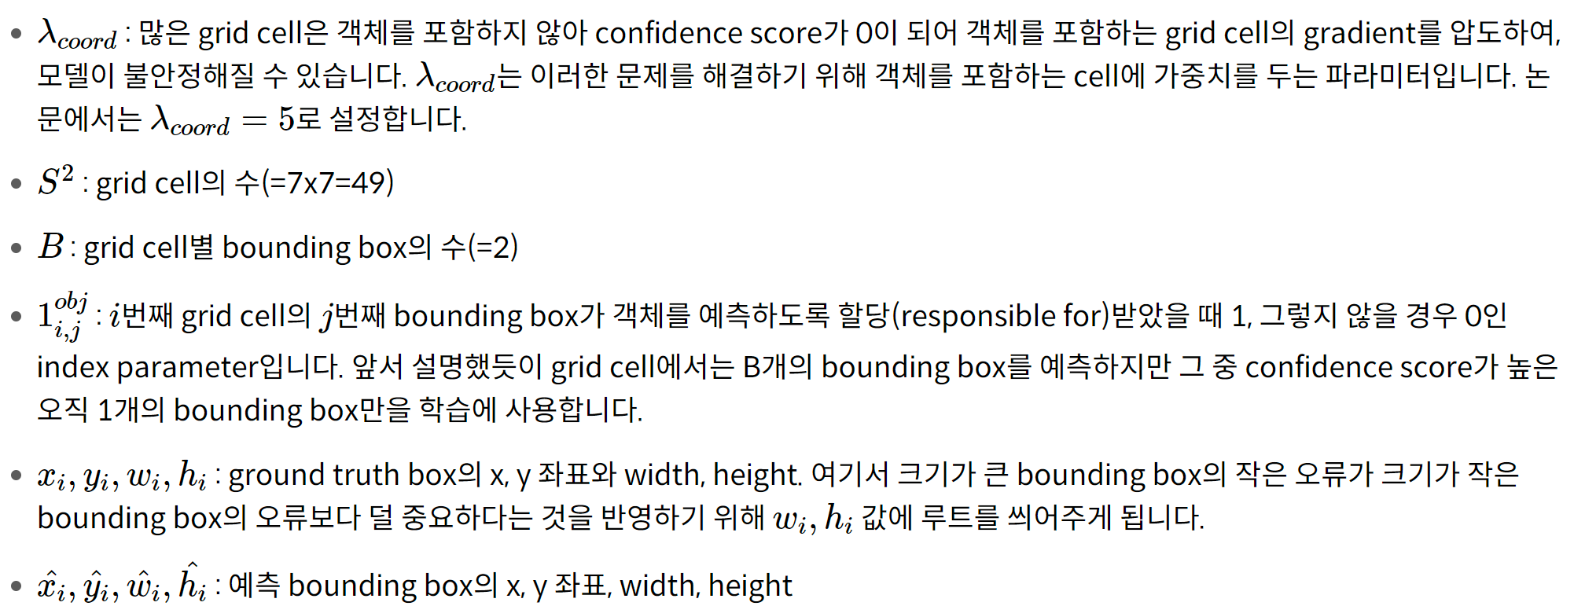
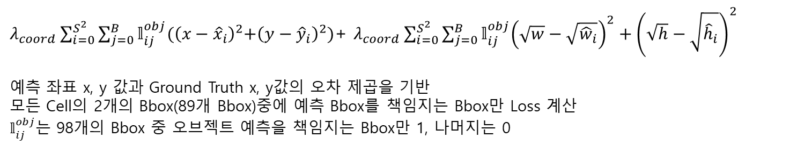
BBox 중심 x, y좌표Loss
$λ_{coord}\sum_{i=0}^{S^{2}}{\sum_{j=0}^{B}{𝕝_{ij}^{obj}{(\left(x−{\hat{x}}_{i}\right)}^{2}+{\left(y−{\hat{y}}_{i}\right)}^{2}}})$+ $λ_{coord}\sum_{i=0}^{S^{2}}{\sum_{j=0}^{B}{𝕝_{ij}^{obj}{\left(\sqrt{w}−\sqrt{{\hat{w}}_{i}}\right)}^{2}+{\left(\sqrt{h}−\sqrt{{\hat{h}}_{i}}\right)}^{2}}}$
예측 좌표 x, y 값과 Ground Truth x, y값의 오차 제곱을 기반
모든 Cell의 2개의 Bbox(89개 Bbox)중에 예측 Bbox를 책임지는 Bbox만 Loss 계산
$𝕝_{ij}^{obj}$는 98개의 Bbox 중 오브젝트 예측을 책임지는 Bbox만 1, 나머지는 0

Slide 43
30
pred
20
25
0.9
0.5
21:25
26:30
target
20
7
1
7
21:25

Slide 44
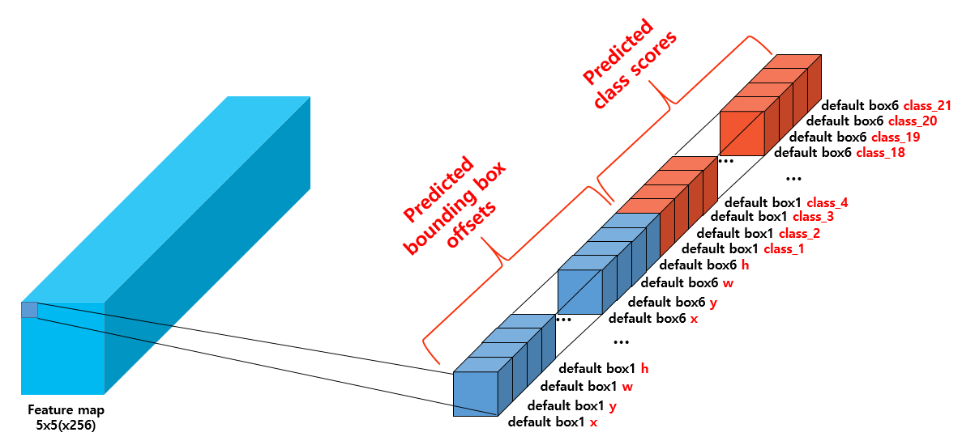

Slide 45
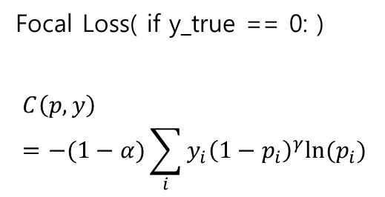
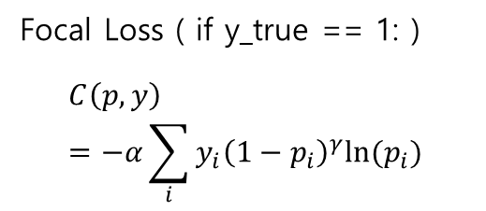
def call(self, y_true, y_pred):
cross_entropy = tf.nn.sigmoid_cross_entropy_with_logits(
labels=y_true, logits=y_pred
)
probs = tf.nn.sigmoid(y_pred)
alpha = tf.where(tf.equal(y_true, 1.0), self._alpha, (1.0 - self._alpha))
pt = tf.where(tf.equal(y_true, 1.0), probs, 1 - probs)
loss = alpha * tf.pow(1.0 - pt, self._gamma) * cross_entropy
return tf.reduce_sum(loss, axis=-1)
Focal Loss ( if y_true == 1: )
$$C\left(p,y\right)=−α\sum_{i}{y_{i}{\left(1−p_{i}\right)}^{γ}ln⁡(p_{i})}$$
Focal Loss( if y_true == 0: )
$$C\left(p,y\right)=−(1−α)\sum_{i}{y_{i}{\left(1−p_{i}\right)}^{γ}ln⁡(p_{i})}$$

Slide 46
def call(self, y_true, y_pred):
cross_entropy = tf.nn.sigmoid_cross_entropy_with_logits(
labels=y_true, logits=y_pred
)
probs = tf.nn.sigmoid(y_pred)
alpha = tf.where(tf.equal(y_true, 1.0), self._alpha, (1.0 - self._alpha))
pt = tf.where(tf.equal(y_true, 1.0), probs, 1 - probs)
loss = alpha * tf.pow(1.0 - pt, self._gamma) * cross_entropy
return tf.reduce_sum(loss, axis=-1)
Focal Loss ( if y_true == 1: )
$$C\left(p,y\right)=−α\sum_{i}{y_{i}{\left(1−p_{i}\right)}^{γ}ln⁡(p_{i})}$$
Focal Loss( if y_true == 0: )
$$C\left(p,y\right)=−(1−α)\sum_{i}{y_{i}{\left(1−p_{i}\right)}^{γ}ln⁡(p_{i})}$$

Slide 47
def call(self, images, training=False):
c3_output, c4_output, c5_output = self.backbone(images, training=training)
p3_output = self.conv_c3_1x1(c3_output)
p4_output = self.conv_c4_1x1(c4_output)
p5_output = self.conv_c5_1x1(c5_output)
p4_output = p4_output + self.upsample_2x(p5_output)
p3_output = p3_output + self.upsample_2x(p4_output)
p3_output = self.conv_c3_3x3(p3_output)
p4_output = self.conv_c4_3x3(p4_output)
p5_output = self.conv_c5_3x3(p5_output)
p6_output = self.conv_c6_3x3(c5_output)
p7_output = self.conv_c7_3x3(tf.nn.relu(p6_output))
return p3_output, p4_output, p5_output, p6_output, p7_output
P7
Predict
p7(1,7,7,256)
3x3
top-down
P6
Predict
3x3
p6(1,13,13,256)
M6
p6(1,13,13,256)
bottom-up
p5(1,25,25,2048)
conv5(C5)
stride 32
1x1
p5(1,25,25,256)
0.5x
M5
P5
Predict
(1,50,50,1024)
1x1
2x
conv4(C4)
stride 16
$$+$$
p5(1,25,25,256)
p4(1,50,50,256)
(1,100,100,512)
M4
3x3
P4
0.5x
Predict
conv3(C3)
stride 8
1x1
2x
p4(1,50,50,256)
$$+$$
p3(1,100,100,256)
M3
3x3
P3
Predict
p3(1,100,100,256)
0.5x
image

